Slide 1

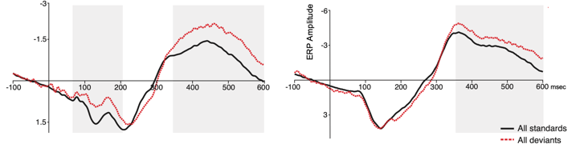
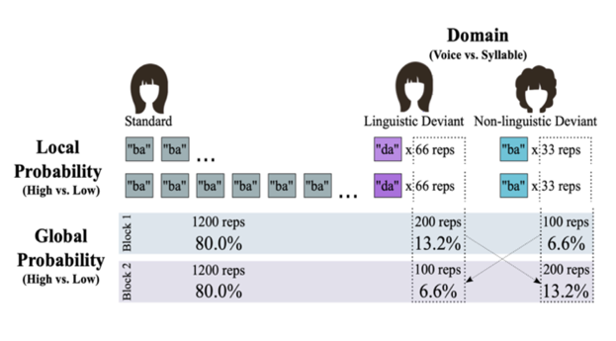
Neural sensitivity to local and global distributional information in speech changes as a function of development
¹ University of Delaware
² Louisiana State University
Yi-Lun Weng¹ Julie M. Schneider^{1,2} Zhenghan Qi¹
an MMN
The goals
ERP results
Summary
Children are sensitive to regularities within their environment.
However, it is unclear whether and how the neural sensitivity to distributional cues in speech changes from childhood to adulthood.
The present study used MMN and LDN to measure listeners’ sensitivity to deviant probability to investigate whether sensitivity to distributional information in children resembles that seen in adults.
Cluster-based permutation test within the Mass Univariate Toolbox
All deviants versus all standards:
Adults: MMN (60 - 214 ms) and an LDN (350 - 560 ms) across a widespread electrodes.
Within the same time windows, children presented a significant LDN, but no MMN.
Importantly, the adult group results showed that the amplitude of LDN was modulated by the effect of global probability: a larger LDN elicited by low-global than high-global deviants.
The significant Group X Global X Local interaction (p < .05) confirmed a developmental difference between children and adults in processing global and local probabilistic information.
Adults
Children
Pz
LDN
Pz
LDN
MMN
Methods
Passive auditory oddball paradigm
Experiment 1 = 45 adults (Mean = 22.76 years, SD = 3.02 years)
Experiment 2 = 22 children (Mean = 10.2 years, SD = 1.99 years)
Design:
1. Global probability (High freq vs Low freq)
2. Local probability (High freq vs Low freq)
3. Domain(Voice vs Syllable)
Discussion
Average Adult ERP Amplitude
Average Child ERP Amplitude
The LDN in children suggests that processing of global probabilistic information distributed in speech is automatic.
The trend towards a P300 in adults indicates detection of global probabilistic might be facilitated by more attentive processes.
Global probability
Global probability
Adults show a significant interaction between global and local probability
Children only show a main effect of global probability
QLAB at UDel
@udelqlab

Slide 2
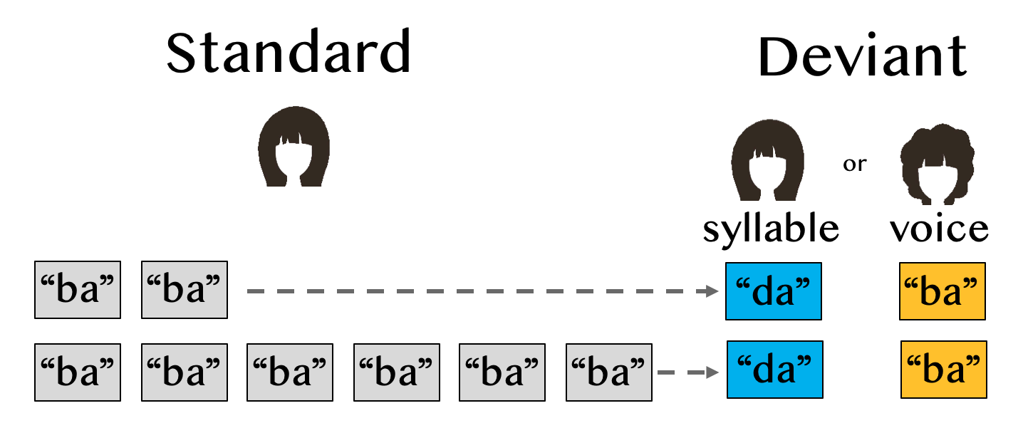
Local
Probability
High freq vs. Low freq
Global
Probability
High freq vs. Low freq
block1 block 2
80% in both block1 &2
(1200 reps)
13.2% 6.6%
High Low

Slide 3
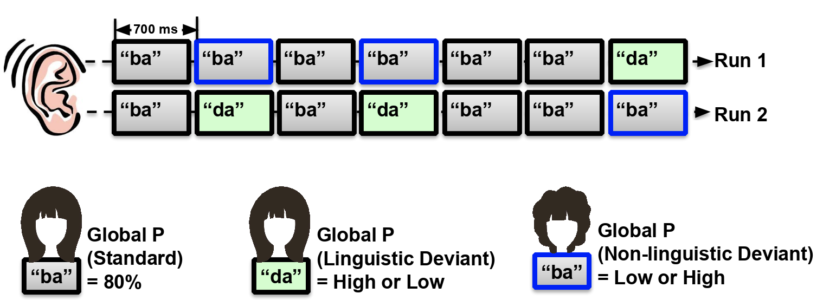
Standard
Deviant
syllable
voice
Local
Probability
“ba”
“ba”
“da”
“ba”
High Freq
“ba”
“ba”
“ba”
“ba”
“ba”
“ba”
“da”
“ba”
Low Freq
Global
Probability
Block 1
80% (=1200/1500 reps)
13.2% (=200/1500 reps)
6.6% (=100/1500 reps)
Block 2
80% (=1200/1500 reps)
6.6% (=100/1500 reps)
13.2% (=200/1500 reps)
longer time (across block)
Auditory oddball paradigm

